Slide 1
Exercise - Learning Objectives
By the end of this exercise you will be able to:
Define Wind technology generating electricity at the centralized level

Slide 2
Demand for future connections
Natural Gas
Electricity
Demand for electrified population
Natural Gas Production
Hydro run-of-river
Transmission & Distribution
Hydro Dam
Grid Expansion
Natural Gas Imports
Wind
Dist. Solar PV
New CCGT/GT
Dist. Solar PV with battery
Backstop 1
Backstop 2

Slide 3
Demand for future connections
Natural Gas
Electricity
Demand for electrified population
Natural Gas Production
Hydro run-of-river
Transmission & Distribution
Hydro Dam
Grid Expansion
Natural Gas Imports
Wind
Dist. Solar PV
New CCGT/GT
Dist. Solar PV with battery
Backstop 1
Backstop 2

Slide 4
Defining a wind technology
We continue to create a TECHNOLOGY called WIND.
The following parameters are taken into account
OutputActivityRatio: defines the rate of fuel provided (i.e. Electricity)
VariableCost: defines the variable Operation & Maintenance cost ($M/PJ or $/GJ)
CapitalCost: defines the overnight investment cost of the plant ($M/GW or $/kW)
CapacityFactor: represents the variability in generation at each point in time.
OperationalLife: defines the lifetime of the technology (in years)
CapacitytoActivityUnit: defines how much activity can occur by one unit of capacity in one year (in this case we are using GW for capacity and PJ for energy, thus 1 GW can provide 31.536 PJ annually)

Slide 5
Defining a wind technology
For the WIND technology, let’s define the following.
OutputActivityRatio: Choose the SEC_EL fuel and insert the following for mode of operation 1.
Note that for RET, we don’t need to define an input fuel
Mode | 2014 | 2015 | 2016 | 2017 | 2018 | 2019 | 2020 | 2021 | 2022
1 | 1 | 1 | 1 | 1 | 1 | 1 | 1 | 1 | 1
 | 2023 | 2024 | 2025 | 2026 | 2027 | 2028 | 2029 | 2030 | 2031
1 | 1 | 1 | 1 | 1 | 1 | 1 | 1 | 1 | 1
 | 2032 | 2033 | 2034 | 2035 | 2036 | 2037 | 2038 | 2039 | 2040
1 | 1 | 1 | 1 | 1 | 1 | 1 | 1 | 1 | 1

Slide 6
Defining a wind technology
For the WIND technology, let’s define the following.
VariableCost: Insert the following for mode of operation 1.
Mode | 2014 | 2015 | 2016 | 2017 | 2018 | 2019 | 2020 | 2021 | 2022
1 | 4.17 | 4.17 | 4.17 | 4.17 | 4.17 | 4.17 | 4.17 | 4.17 | 4.17
 | 2023 | 2024 | 2025 | 2026 | 2027 | 2028 | 2029 | 2030 | 2031
1 | 4.17 | 4.17 | 4.17 | 4.17 | 4.17 | 4.17 | 4.17 | 4.17 | 4.17
 | 2032 | 2033 | 2034 | 2035 | 2036 | 2037 | 2038 | 2039 | 2040
1 | 4.17 | 4.17 | 4.17 | 4.17 | 4.17 | 4.17 | 4.17 | 4.17 | 4.17

Slide 7
Defining a wind technology
For the WIND technology, let’s define the following.
CapitalCost: Insert the following values.
The OperationalLife can be set to 25 years, while the CapacitytoActivityUnit can be set to 31.536.
 | 2014 | 2015 | 2016 | 2017 | 2018 | 2019 | 2020 | 2021 | 2022
WIND | 1845 | 1808 | 1772 | 1736 | 1702 | 1667 | 1634 | 1601 | 1569
 | 2023 | 2024 | 2025 | 2026 | 2027 | 2028 | 2029 | 2030 | 2031
WIND | 1538 | 1507 | 1477 | 1448 | 1419 | 1390 | 1362 | 1356 | 1349
 | 2032 | 2033 | 2034 | 2035 | 2036 | 2037 | 2038 | 2039 | 2040
WIND | 1342 | 1335 | 1329 | 1322 | 1315 | 1309 | 1302 | 1296 | 1289

Slide 8
Defining a wind technology
For the WIND technology, let’s define the following.
CapacityFactor: Insert the following values for the entire modelling period.
ID | 0.25
IN | 0.25
SD | 0.25
SN | 0.25
WD | 0.25
WN | 0.25

Slide 9
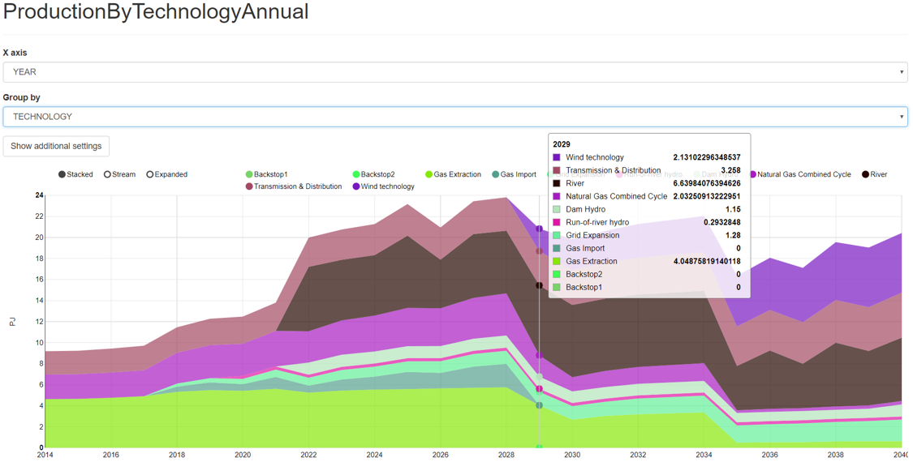
Run the model and check the results!

